Slide 1
Front-end
Framework: Semantic/Fomantic UI
Jquery
Sass
Back-end
Framework: Express and Node
Database: Postgress
Deployement:
AWS
Heruko
HERUKO AND NETLIFY

Slide 2
Doug:
Landing
Singin
Singnup
profile
Ali:
- Feed
- Browse
- design and responisivness
Jay:
Popular
My resource
Add resource
search

Slide 3
Friday TODO:
Exercise
Choosing a project
Listing all features
Importance of features
Endpoints (gets/posts..)
Designing database ERD
Creating Repo
Timeframe
Splitting the work
Eslintrc (prettier)

Slide 4
Stories
users should be able to save an external URL along with a title and description
users should be able to search for already-saved resources created by any user
users should be able to categorize any resource under a topic
users should be able to comment on any resource
users should be able to rate any resource
users should be able to like any resource
users should be able to view all their own and all liked resources on one page ("My resources")
users should be able to register, log in, log out and update their profile

Slide 5
Pages
Landing page
Login/Register
Home (collections - add resource - search(header) - my resources)
Profile
Deep freeze:
Side bar of categories
Right side bar popular
Tags
Checkout other users profile
Delete users

Slide 6
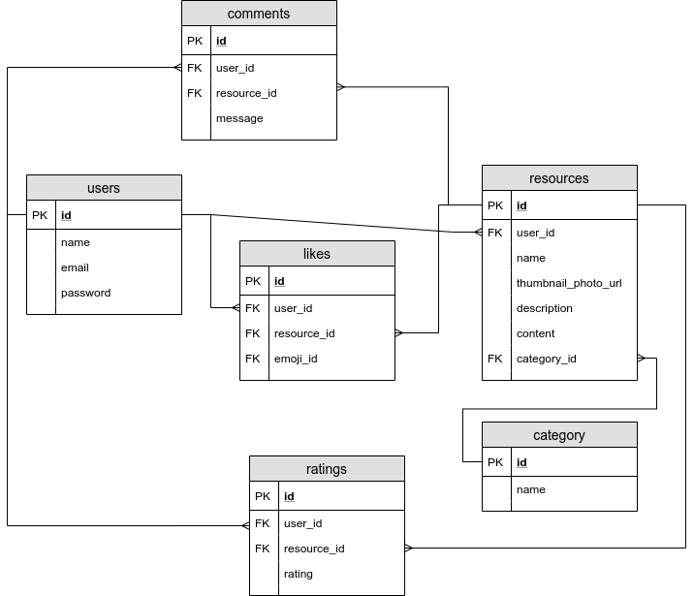
ERD

Slide 7
Endpoints (pages)
get(“/”) - Landing page (if logged in redirects to home page)
get(“/login”)
get(“/register”)
get(“/home”) - Home (collections - add resource - search(header) - my resources)
get(“/profile”) (if signed in - your profile) otherwise redirect back login

Slide 8
Endpoints (posts)
post(“/register”)
put(“/login”)
put(“/logout”)

Slide 9
Endpoints (JSON)
Get (user_information) (/user/info)
Put (/user/info)
Get (resources for user that he created and liked) (/user/resources)
Get (resources) (/resources)
Post (resource) (/resources)
Delete (/resources)
Patch (/resources)
Post (/like)
Delete (/like)
Post (/rating)
Patch (/rating)
Delete (/rating)
Post (/comment)
Patch(/comment)
Delete(/comment)

Slide 10
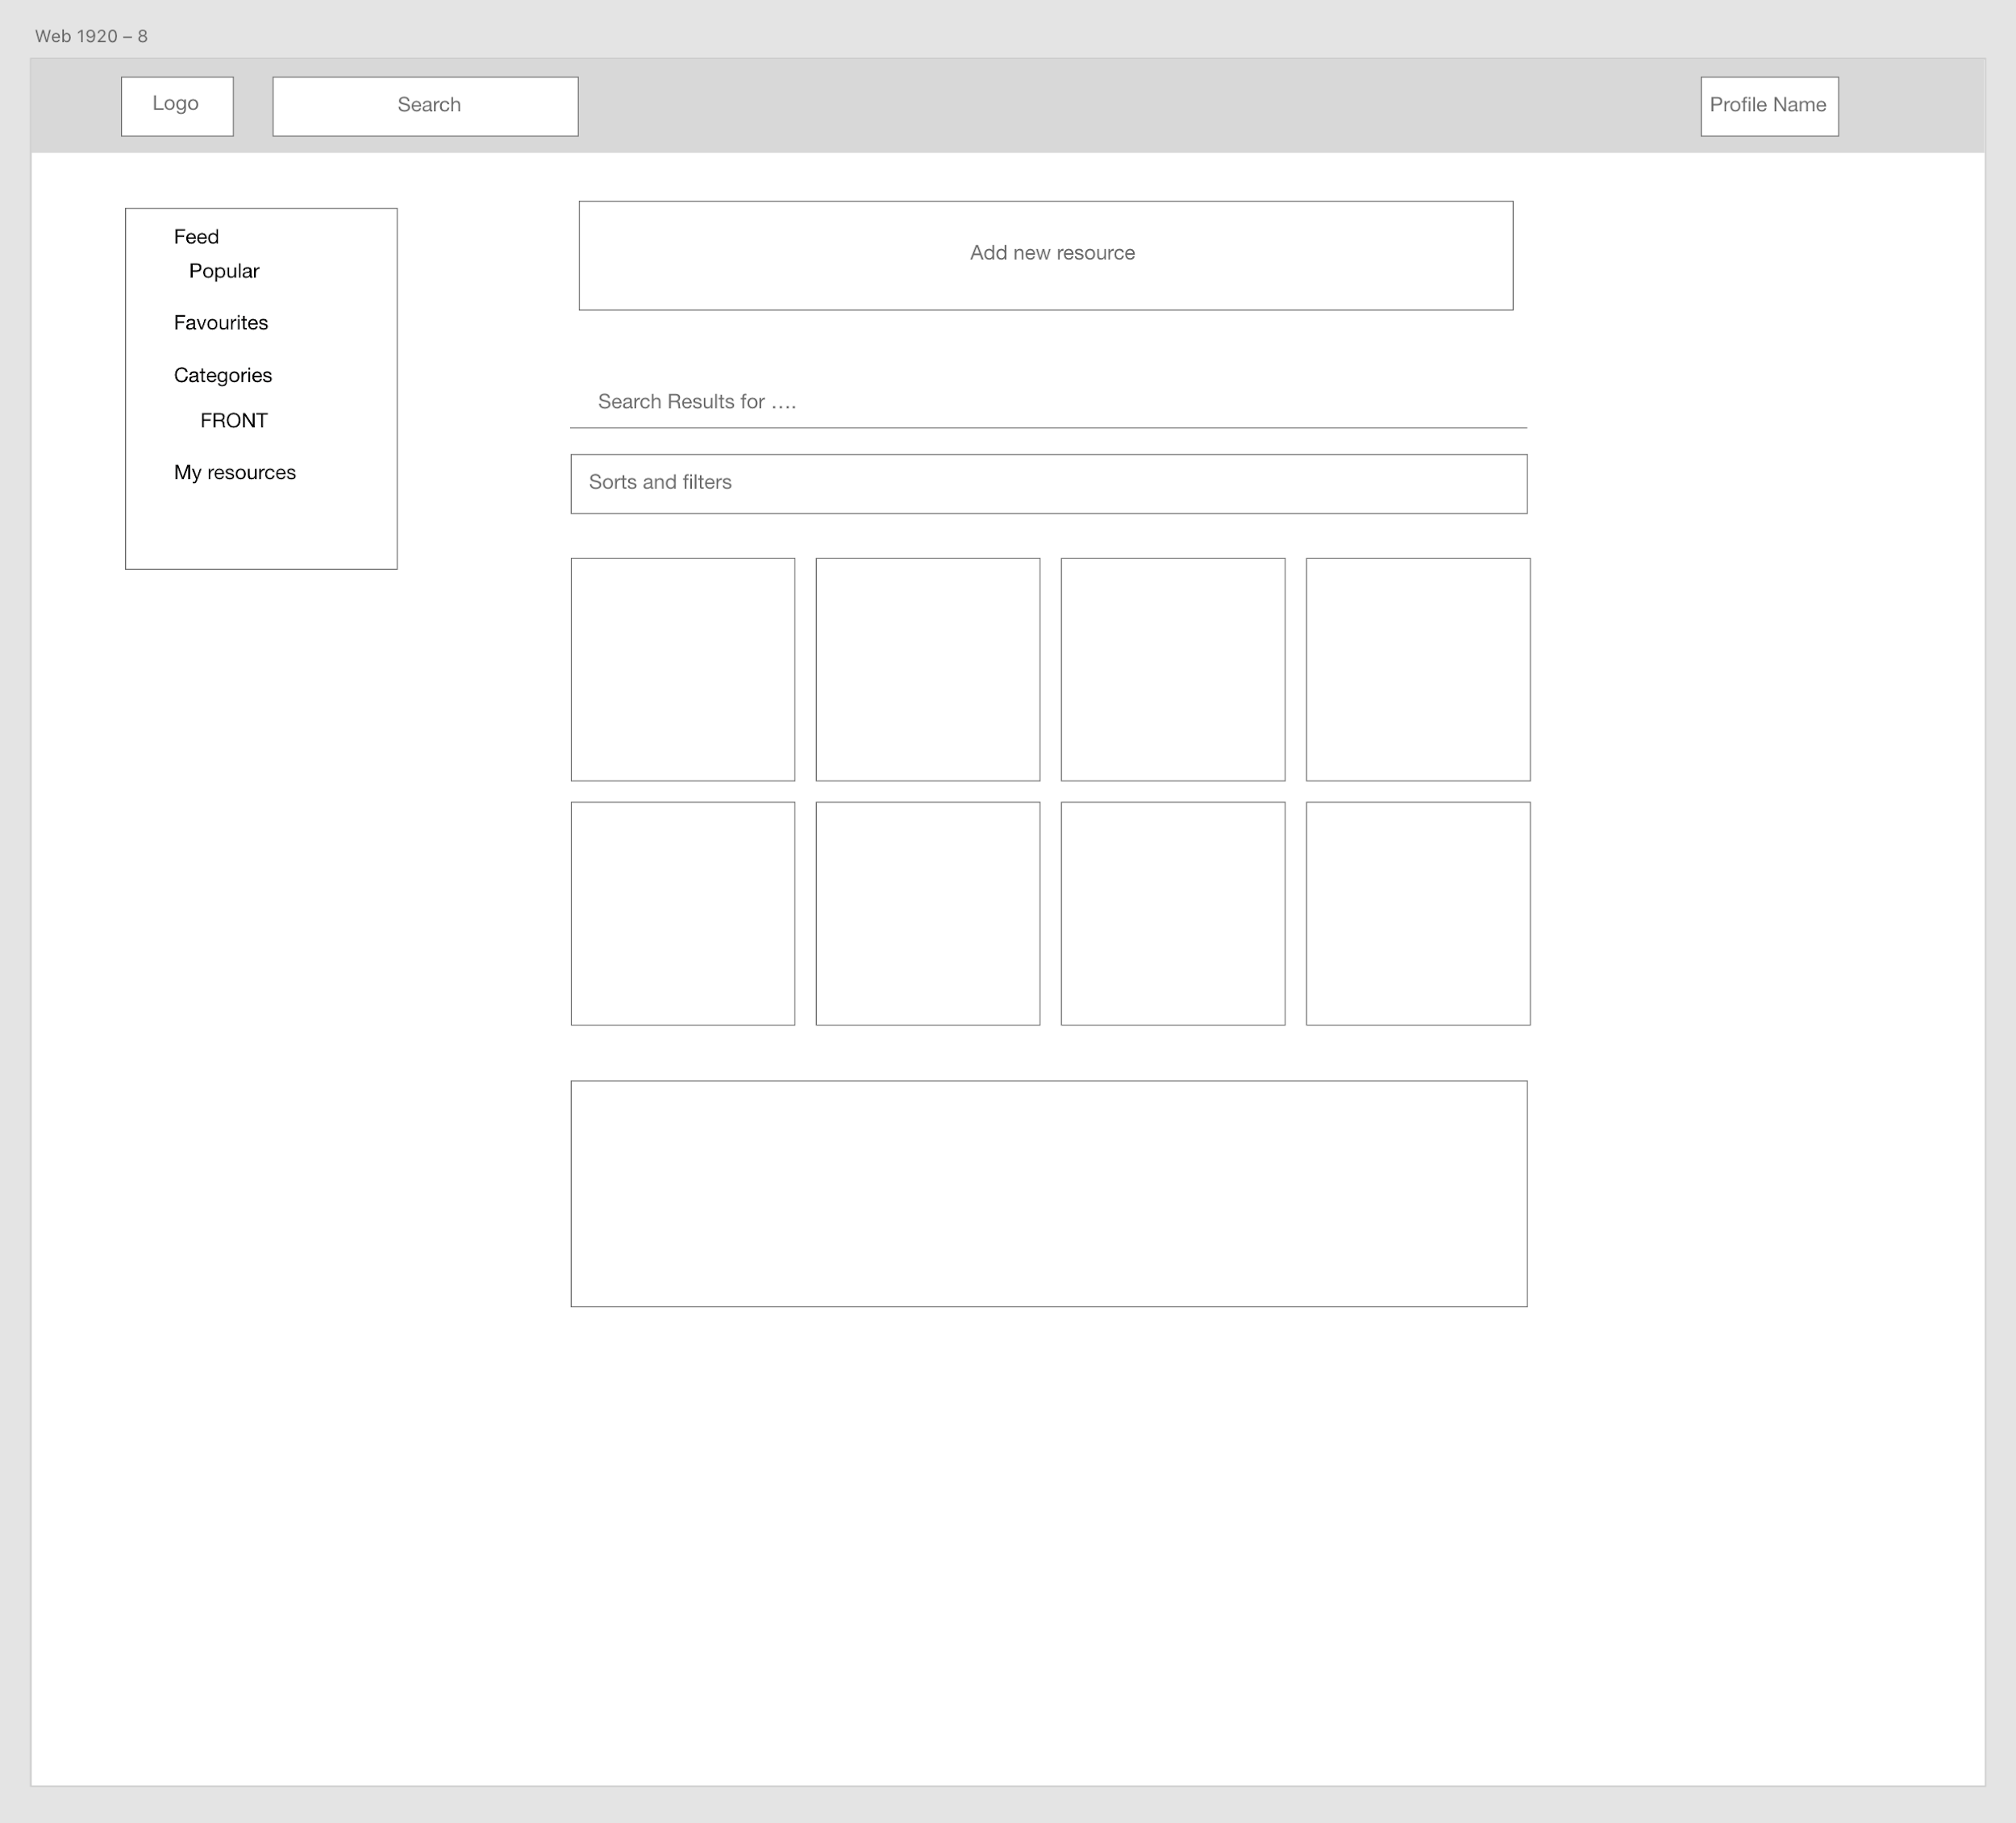
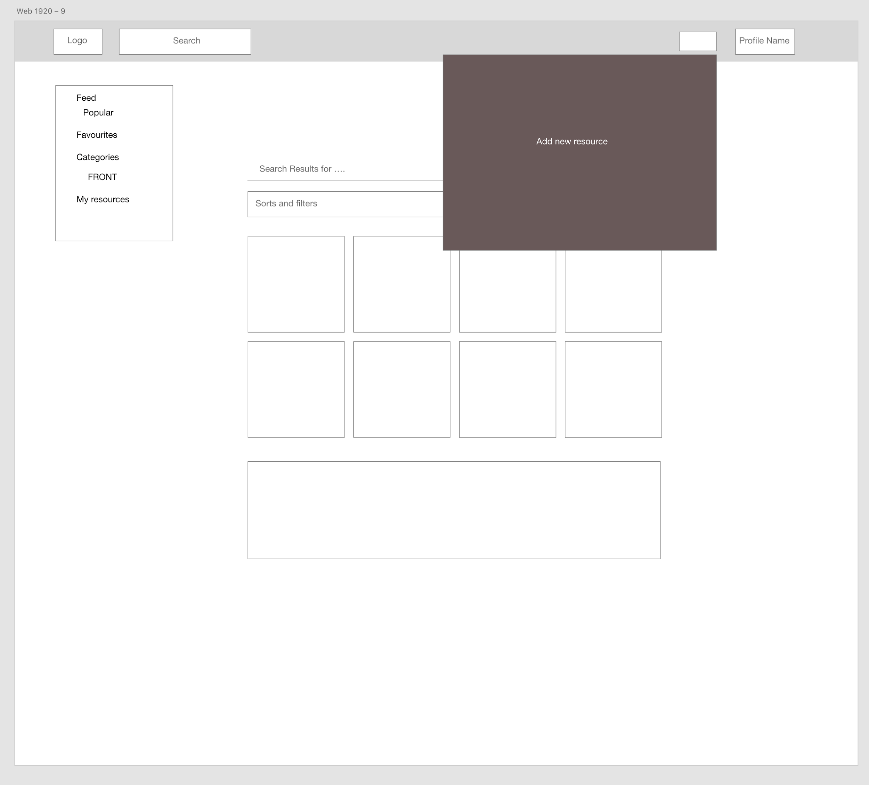
Design (Home)

Slide 11
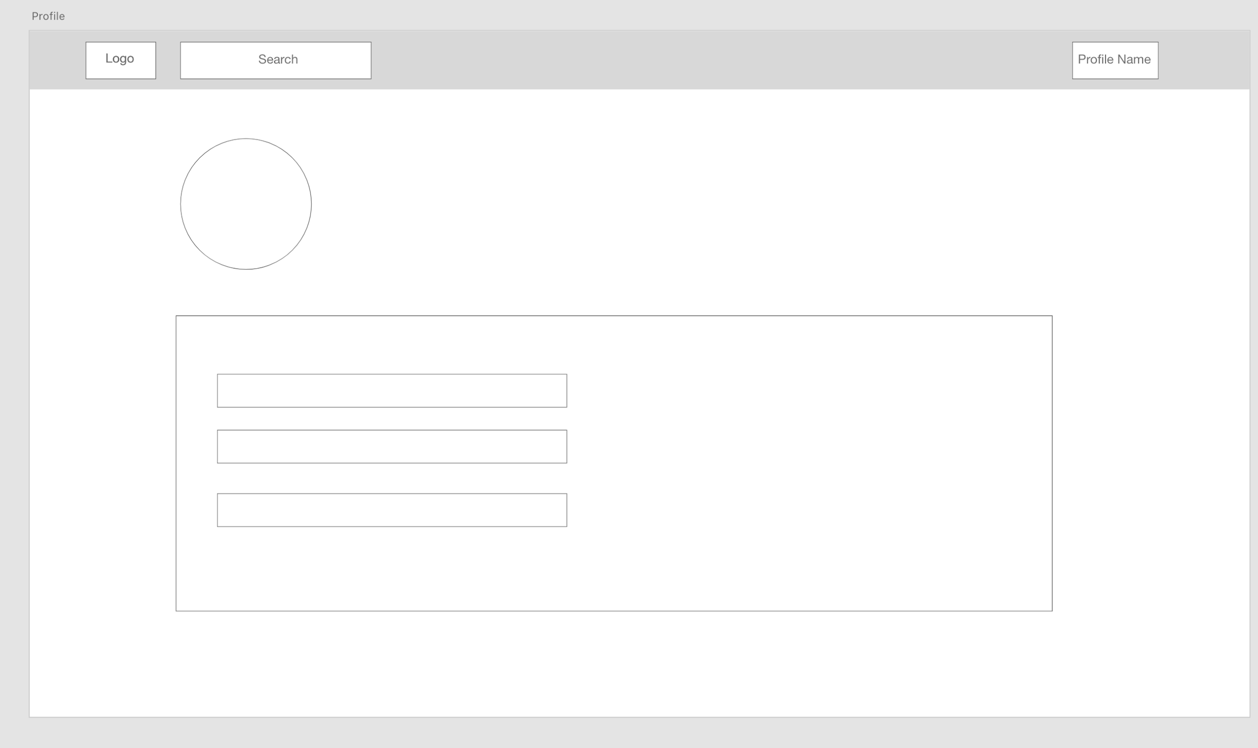
Design (Profile)

Slide 12
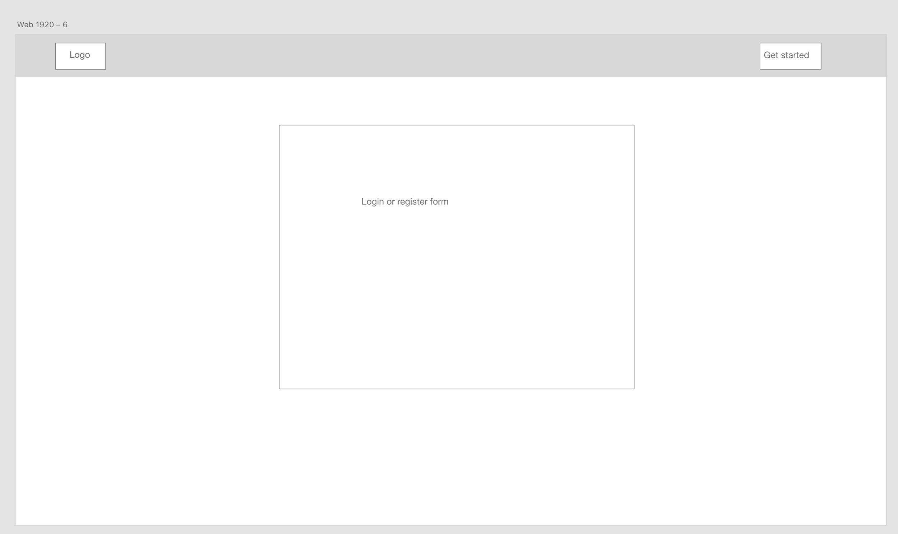
Design (Sign in/register)

Slide 13
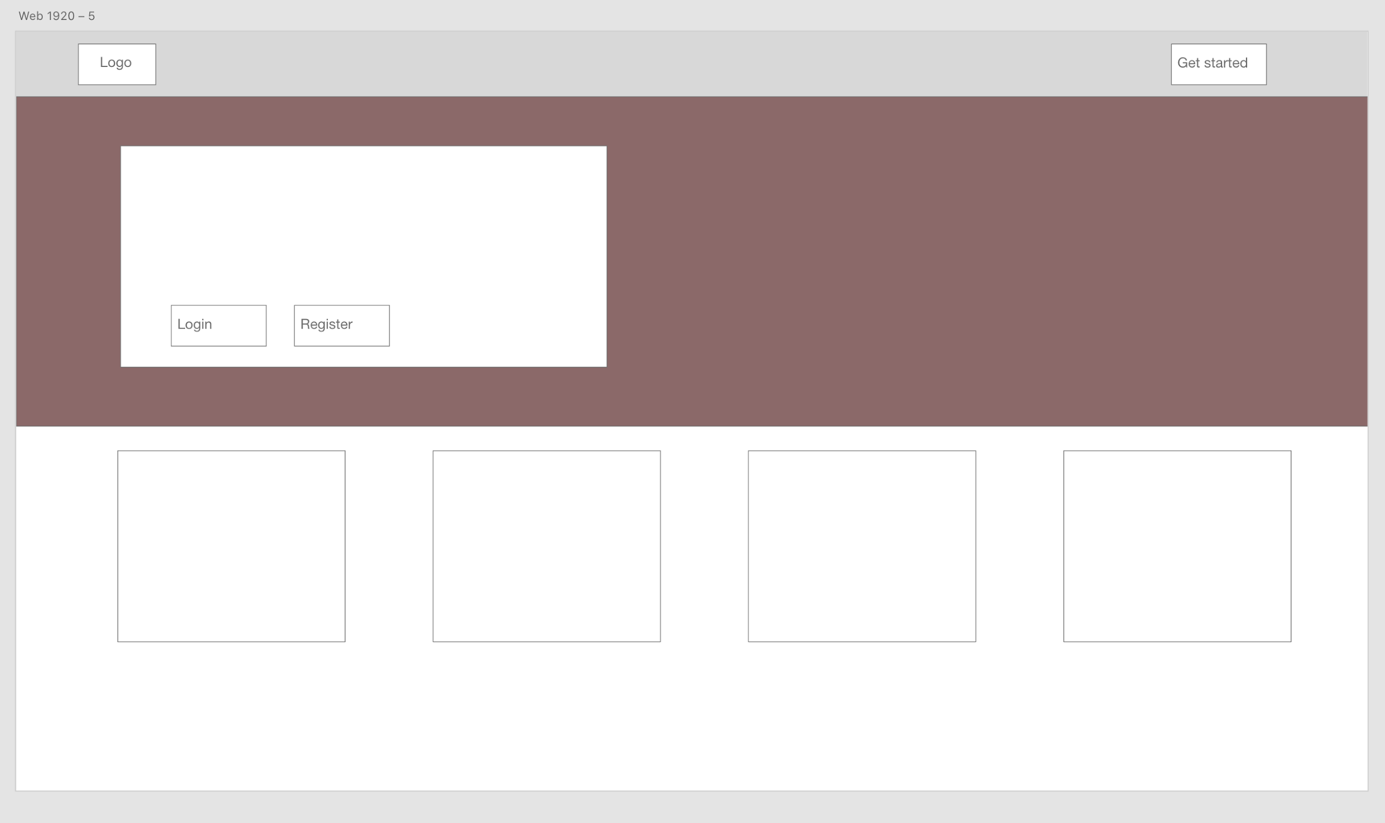
Design (Landing)

